Slide 1
Quiet Skies Puget Sound
Debi Wagner
Origin Story
The Third Runway
Burien City Councilmember / Author, “Over My Head”
The City Council

Slide 2
Quiet Skies Puget Sound
The problem with proof
What did we know and when did we know it?
Are things improving with new engine technology and efficiency?
Ultrafine particles
Toxic crop dusted and poison circles
What is so bad about all these chemicals?
Conclusion

Slide 3
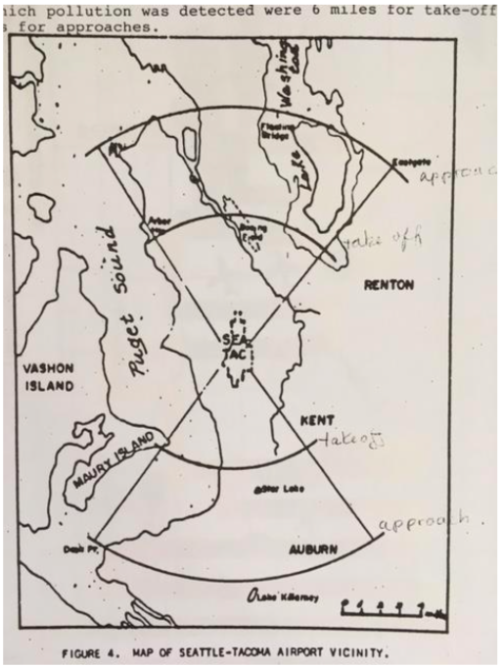
What did we know and when did we know it?
Early evidence-1970
Map shows fan shaped impact area of primarily soot
12 miles from the runway ends on approach
6 miles for departures
Overhead aircraft have ground level impact at 3,000 ft. and below

Slide 4
What did we know and when did we know it?
One of the earliest studies of emissions at Sea-Tac warned that emissions were already too high
In 1973, ESL recommended avoiding building a gas station due to high hydrocarbon levels, avoid any new sources like putting in any grinding or dust causing industry due to already high particulate levels. All recommendations were ignored
A local politician who lived near the airport who was instrumental in requesting the study put his house up for sale and moved away within only a few months after the study was published. Some of his neighbors developed cancer including a family, both parents, child and dog.
1991 Department of Ecology study warned emissions, especially benzene known to cause leukemia, were higher than expected, particulate and nitrogen dioxide violating the federal air quality standard and made numerous recommendations for reduction, mostly ignored

Slide 5
What did we know and when did we know it?
In 1993, McCulley Frick and Gilman took air samples in the areas around Sea-Tac for four days and eight hour periods and found higher than acceptable levels of benzene, formaldehyde, acrolein, and other air toxics. If Sea-Tac were a smokestack, the local air regulatory agency would have shut down the airport.
Airports are not controlled or monitored as sources of air pollution so they are exempt from regulation.
At this same time, EPA found that estimated levels of air toxics at Midway Airport in Chicago were contributing to a higher than acceptable lifetime cancer risk increase in a community near the airport.

Slide 6
Are things improving with new engine technology and efficiency?
NE States For Coordinated Air Use Management 2004
How have emissions changed over time?
Airports claim emissions are going down
Chart indicates this is not the case
In the years 1970 to 1998, Nitrogen oxide emissions increased by 133% while all other industry and cars increased by 3% or less in the same time period
One aircraft 2 minute takeoff is equal to nitrogen oxide levels of 21,530 cars
One 10 minute 747 idle is equal to sulfur oxides of half a million cars and carbon monoxide levels of 8,000 cars
Air quality impacts is completely dependent on the fuel. There have been no changes in Jet A fuel since 1960

Slide 7
Are things improving with new engine technology and efficiency?
Aviation is the fastest growing contributor to climate change emissions in the world
There are currently no controls for 7.8 billion tonnes international increase expected between present and 2040
All other toxics, criteria pollutants, metals, aerosols, soot are included in this increase
In 2007, jet aircraft at Sea-Tac were contributing 22% of the county total, the largest single contributing facility in the county
By 2030, jets may contribute half the county total

Slide 8
Ultrafine particles
A recent study of ultrafine particulate at LAX found amounts equal to an entire freeway network dusted onto neighborhoods in approach zones for 10 miles from the runway ends
There appears to be little doubt the source is overhead aircraft
Ultrafine particulate causes inflammation of the lungs
Please notice the fan shaped area nearly identical to the 1970 map 45 years later

Slide 9
Ultrafine particles
After the LAX study was released the FAA questioned whether the aircraft were the primary source
Dr. Yost at UW did a follow up study at LAX and Atlanta Hartsfield airports to measure the size of the ultrafine
His findings are alarming. The size is uniquely small, 10 nm on average. Dr. Larson at the UW says this is so small it is never seen in the environment. Ground transportation ultrafine is typically much larger at 35 to 50 nm
A further study found aircraft vortex is bringing this ultrafine particulate directly to the ground moments after an aircraft passes overhead on arrivals
This ultrafine is so small it can penetrate the body through the eyes and when inhaled cross the membrane barrier entering the bloodstream, ultimately reaching the heart and brain
A great concern would be what the soot host is carrying into the body of the combusted jet fuel that contains carcinogenic material, metals, PAH, aerosols

Slide 10
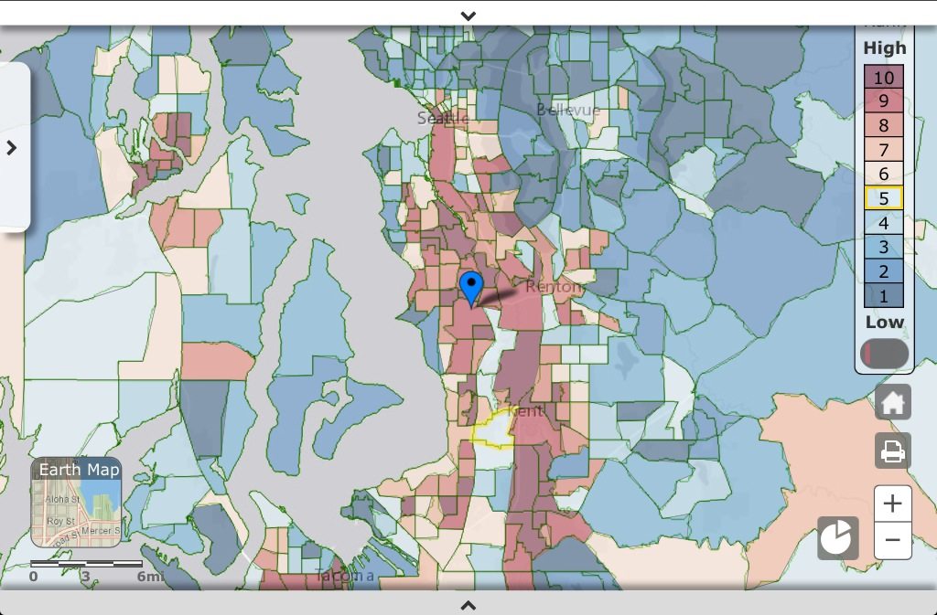
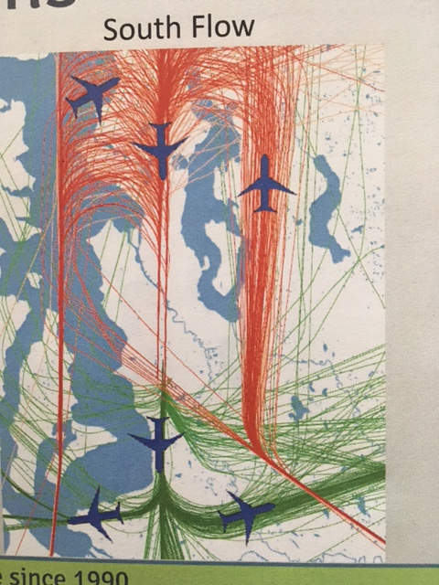
Toxic crop dusted and poison circles
Note the brown areas within the flight tracks that curve to the north and south following the path

Slide 11
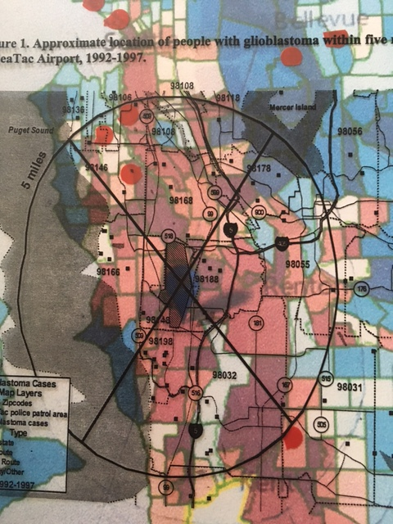
Toxic crop dusted and poison circles
The red dots represent Puget Sound Clean Air Agencies regional monitors
The X represents the fan shaped area identified in 1970
The circle represents the five mile area the State Department of Public Health identified in 1998 for years 1992-95
This area included cancer cases much higher than expected for glioblastoma brain tumors, lung, throat, esophagus, larynx, breast cancer among others
They also discovered a 51% higher than county average hospitalization rate for children age 0-17 for lung related illness

Slide 12
What is so bad about all these chemicals?
We are not alone
Boston Logan airport area has:
360% increase in childhood asthma
200% increase in COPD
O’Hare reports 50 times higher cancer rate hot spots near the airport
Oakland and Santa Monica airports predict risk is 10 times greater for people living/working near airports of study

Slide 13
What is so bad about all these chemicals?
Environmental Factors Like Pollution Cause a Quarter of Deaths, W.H.O. Says “One of the biggest scourges was air pollution, which caused not only lung and respiratory infections but also heart disease and cancer. NY Times 3/15/16
Dr. Mark Witten, the world’s leading jet fuel toxicologist has recently said; “I inspected the Santa Monica Airport several years ago and there is no doubt in my mind that it is a health hazard for the people who live near this site. I observed the same partially combusted jet fuel ‘soot’ particles that I did at the Montana Air National Guard Base in Great Falls, MT on Santa Monica homes near the Santa Monica airport. Our research over the years showed that jet fuel exposure can initiate lung disease and severely adversely affect the immune system.”
Professor Ken Bradstock, clinical associate professor of medicine at Westmead Hospital’s haematology Department said; “The most carcinogenic of the substances involved in jet fuel usage are the benzpyrene emissions, in particular the soot from jet fuel is highly carcinogenic in animal experimentations…logic suggested that such levels of exposure over decades would inevitably translate into an excess of deaths from lung and other cancers.” The Journal of Epidemiology and Community Health reported in April 1997 on research by the University of Birmingham Medical School which found that children born near sources of atmospheric pollution, including major airports, are up to 20% more likely to die of leukemia and solid tumor (nonblood) cancers before they reach adulthood.”
New Jersey Institute of Health recently found that people living and working within 10 miles of a commercial airport are exposed to air toxics from airport sources 10 times the normal level

Slide 14
What is so bad about all these impacts?
98168 and 98198 zip codes where over 70,000 people live, work and play has some of the highest rates of exposure, risk and negative health outcomes in the state. Some census tracts in 98198 have a cancer rate 60% higher than state average.
Airport produced emissions can cause or contribute to lung illness, pneumonia, burning eyes, sore throat, asthma, leukemia, tumors, brain cancer, lung cancer, dizziness, agitation, hypertension, COPD, sluggishness, loss of work time, pet cancers, immune disease, heart disease, blood oxygen depletion, coughing, wheezing, liver cancer, lymphoma, frustration, feeling of helplessness, depression, early death, higher all causes of death, lower life expectancy and higher cost of dying
There are several hundred thousand people living in the brown. Where do these individual health and life losses get figured into the Port of Seattle’s cost of doing business?
If you consider 40% of passengers passing through Sea-Tac are not destination, we are giving up our health for airline profits and convenience for strangers. It is a lot to ask without ever actually asking us

